Slide 1


Flight price prediction
PROJECT

Slide 2

PROBLEM STATEMENT
Flight ticket prices can be something hard to guess, today we might see a price, check out the price of the same flight tomorrow, and it will be a different story.
To solve this problem, we have been provided with prices of flight tickets for various airlines between the various months and between various cities, using which we aim to build a model which predicts the prices of the flights using various input features.

Slide 3
PROBLEM UNDERSTANDING
Data science comes as a very important tool to solve problems in the domain to help the people to predict best flight fares. Predictive modelling, Market mix modelling, recommendation systems are some of the machine learning techniques used for achieving the desired goals.

Slide 4
EDA (EXPLORATORY DATA ANALYSIS)
EDA is used to analyze and investigate data i.e. data cleaning to get the useful hidden information inside the data. It is used to discover trends, patterns, or to check assumptions with the help of statistical summary and graphical representations.
EDA technique involves Data Visualization and Data cleaning and Wrangling.
In EDA, there are four techniques used:-
Univariate non-graphical
Univariate graphical
Multivariate non-graphical
Multivariate graphical

Slide 5
In EDA, we need to check for the raw data the following things:-
Numerical feature may be present
Categorical feature
Missing or Null values
Presence of Outliers
Data Cleaning
Data Wrangling
POINTS TO REMEMBER IN EDA:-
Understand the dependent and Independent features for analysis.
Correlation which gives the inter relationship between all the features.
Joint plot-Bivariate Analysis
Pair plot-Multivariate Analysis
Categorical plots-Boxplot, Count plot, Bar plot, Violin plot etc.

Slide 6
DATA VISUALIZATION
Data visualization is the graphical representation of information and data in a pictorial or graphical format( for ex-plots, charts and maps).
Data visualization in python can be done using the python data visualization libraries like seaborn and matplotlib.
By using seaborn library we can visualizing the relationship between variables(numerical or categorical).
Seaborn divides plot into the below categories:-
Relational plot
Categorical plots
Distribution plots
Regression plots
Matrix plots

Slide 7
STEPS AND ASSUMPTIONS
Importing necessary libraries
Loading Dataset
Data Visualization and data Cleaning
Separating Dependent and Independent variables
Encoding of Independent variables
Train test Split
Applying algorithm to ML models
Regularization
Hyperparameter tuning
Cross validation (grid search CV or Random search)
Saving the best model

Slide 8
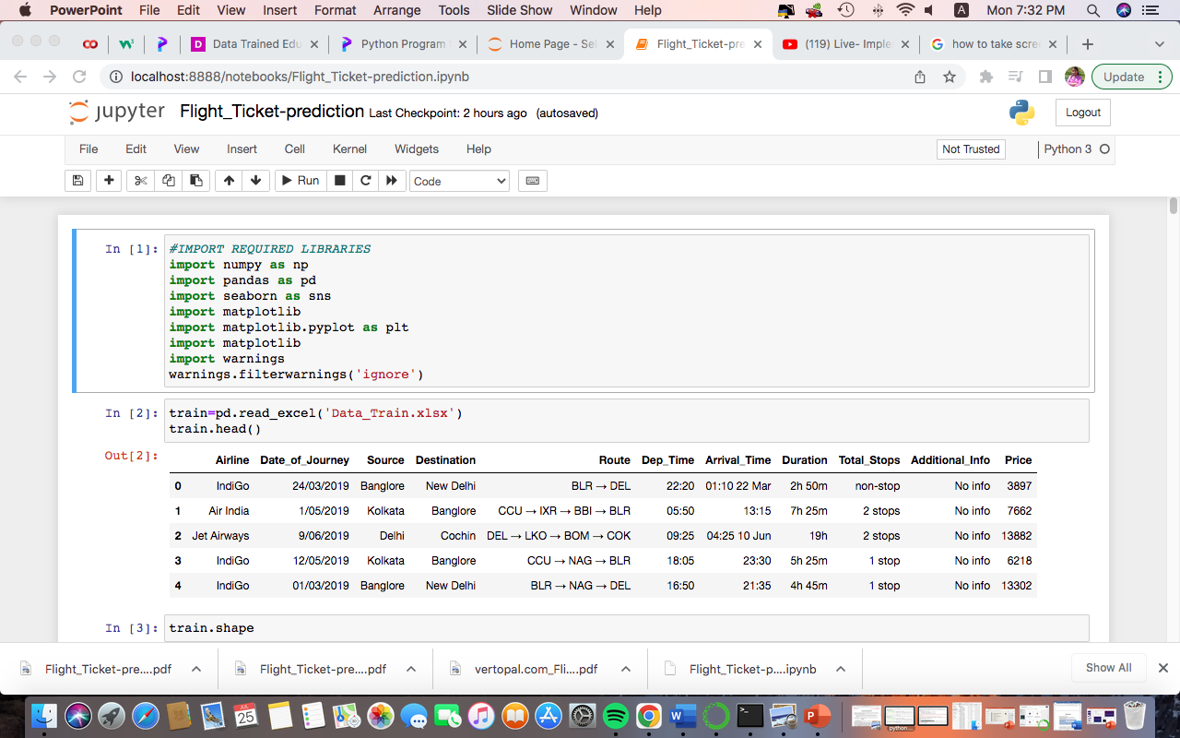
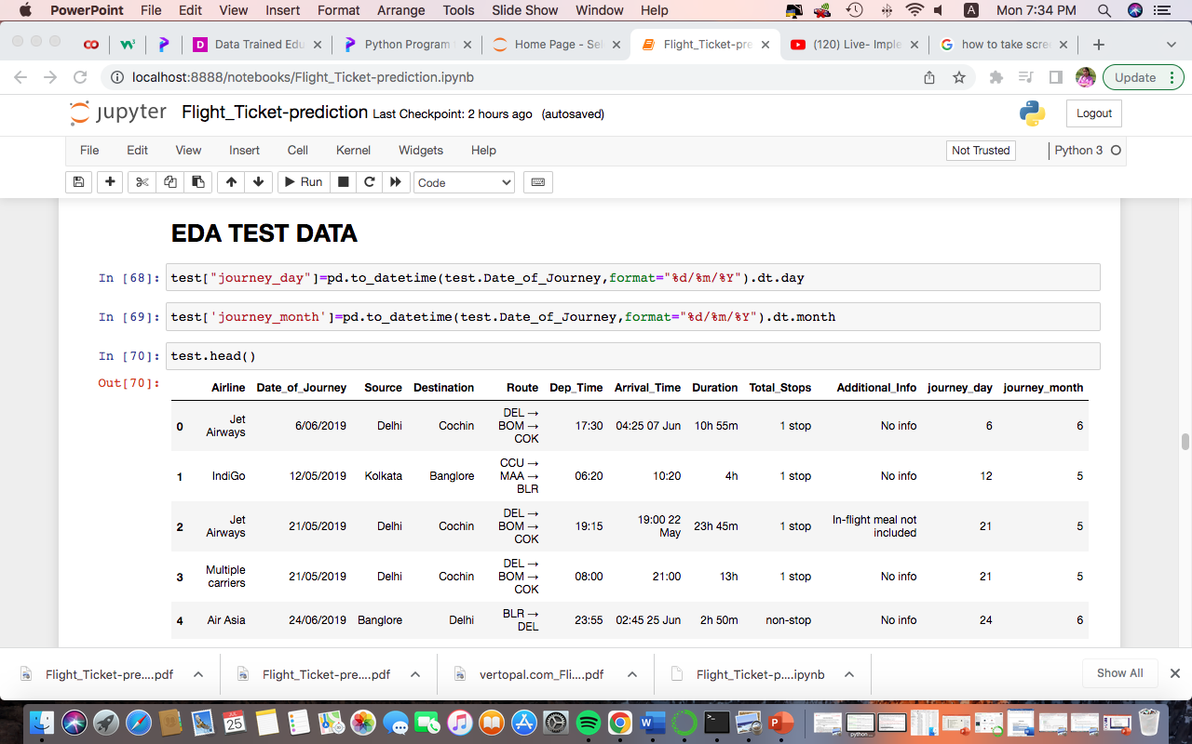
Importing Libraries and loading dataset
Data Cleaning and wrangling

Slide 9
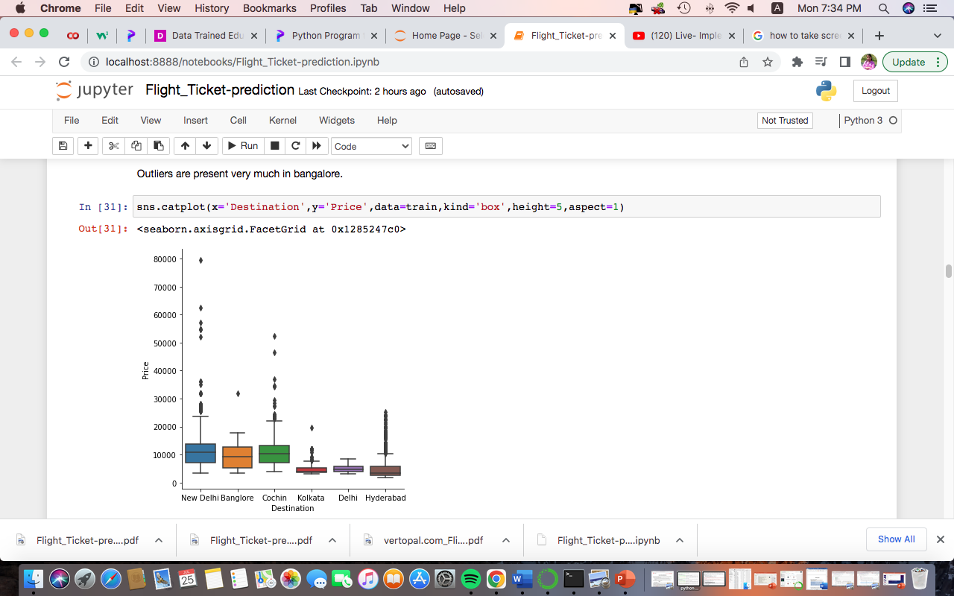
Checking for outliers using Boxplot

Slide 10
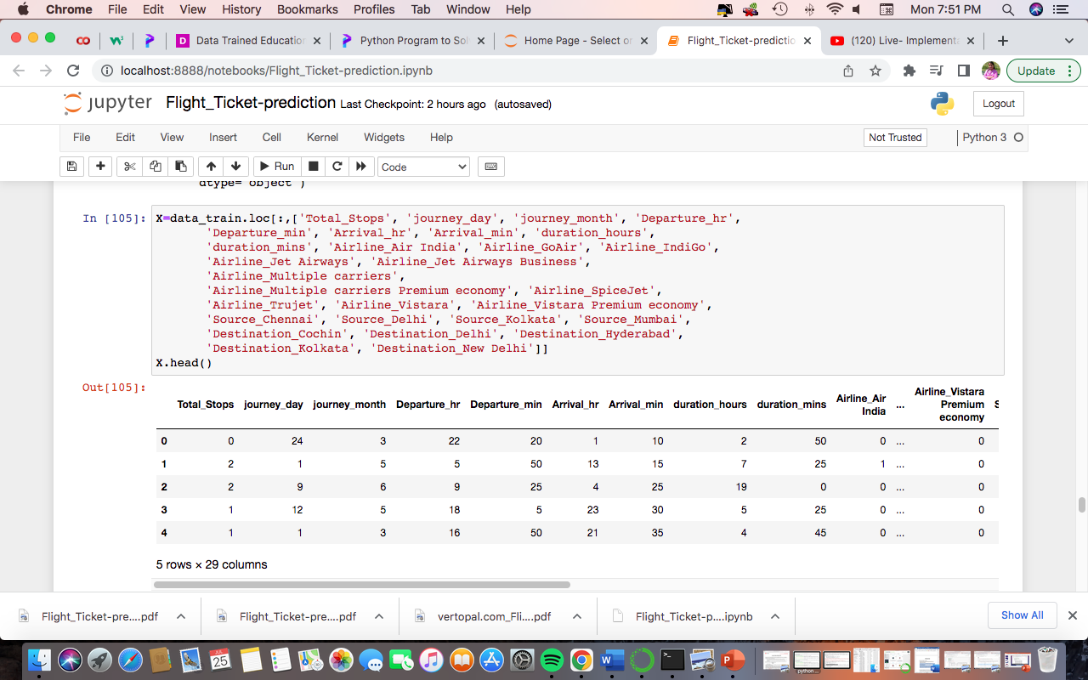
Data Preprocessing

Slide 11
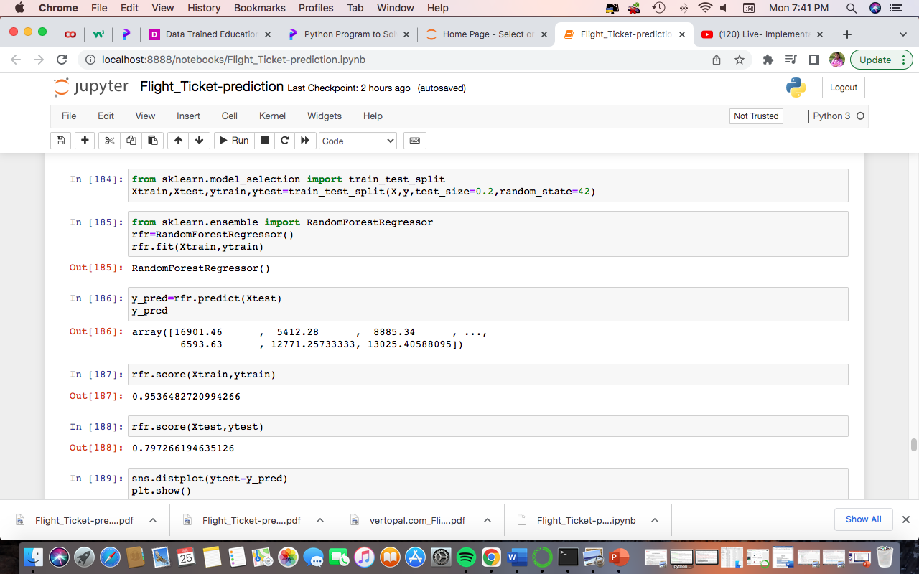
Applying Machine Learning Algorithms

